Slide 1


MANGALORE INSTITUTE OF TECHNOLOGY & ENGINEERING (An ISO 9001:2015 Certified, NAAC Accredited Institution) Badaga Mijar, Moodabidri DEPARTMENT OF ELECTRONICS AND COMMUNICATION ENGINEERING Mini Project Idea Presentation
Title: COMPUTER HUMAN INTERACTION BY GESTURE
Mini Project by:
Ankith Shetty 4MT18EC017
Brayan Saldanha 4MT18EC025
Rohan S 4MT18EC065
Shreeganesha K V 4MT18EC080
Under the Guidance:
Dr.Vinayambika S Bhat
PROFESSOR & HEAD
Department of Electronics & communication Engineering

Slide 2
INTRODUCTION
In recent years, the automation in the domain of robotics motivates the researchers to develop more flexible and simple operable machines such as computer or laptop’s controlled through various hand gestures of humans.
Human Machine Interface (HMI) system plays key role in exchanging the data between computer and human. The current design mainly involved with HMI system that is able to control the system applications such as volume change, scroll up/down during a website and tab change, window change, switching between tasks , play/pause a videoetc., without using any mouse, keyboard, or joystick
The paralyzed people can easily operate their laptops with simple hand gestures using current design.
This methodology provides more flexibility and easy operation; even a nonprofessional can operate the HMI system.

Slide 3
INTRODUCTION
The human can interact with the any real time object (Machine) with five senses i..e sight, hearing, smell, taste and touch.
There are several ways to face the HMI challenge, in this case - hand gestures focused to control the system operations. (Bluetooth,optical gloves,motion technologies) - increase in cost and decrease in hardware.
Our approach is using embedded systems (Arduino),thus decreasing cost but increase in hardware.
The hand gestures are sensed by the ultrasonic sensor to execute the computer applications. . In this system, ultrasonic sensor is directly interfaced with the computer.
The laptop can easily be operated from small distances and up to the range of pre-programmed distances. No external hardware is required to read and control some external peripherals.

Slide 4
PROBLEM STATEMENT
Specially abled people face problems in operating the computer.
The paralyzed people face difficulties to control the system with electronic gadgets.
The infections also spread to others from the infected person if they are using the same PC.
So in order to overcome all these problems we are trying to implement a way to manipulate the operations of laptop or PC without coming in physical contact with it.

Slide 5
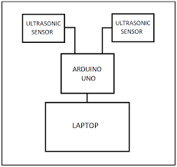
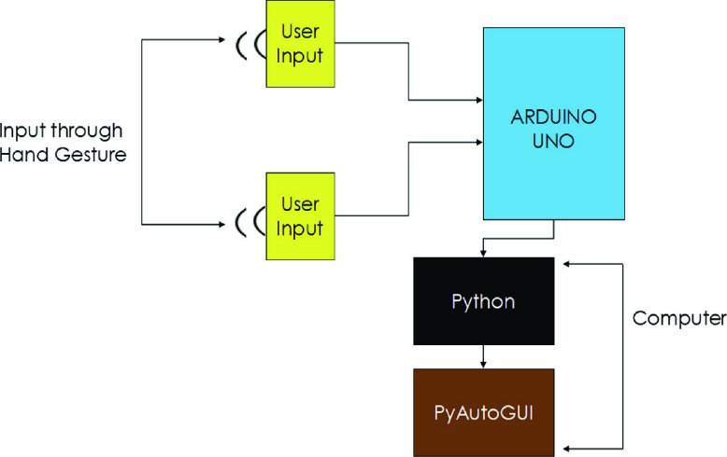
BLOCK DIAGRAM AND DESIGN FLOW

Slide 6
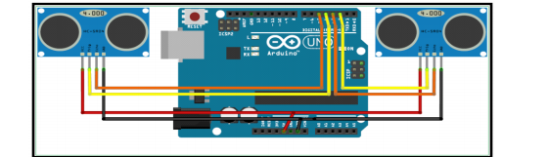
CIRCUIT DIAGRAM AND FLOW CHART
Hand gesture as input
Input is collected by ultrasonic sensor
Inputs are passed as distance values to arduino
Operations are performed using PyAutoGUI
module of computer
Arduino compares input with distinct operations
Operations are passed to python moudules

Slide 7
IMPLEMENTATION
Hardware
Software
Laptop
Microcontroller(Arduino)
Ultrasonic Sensor
Arduino IDE and Python 3.7.1
PyAutoGUI module is used to control the data communication.

Slide 8
METHODOLOGY
Gesture recognition is the main aim of this project. The user places his/her hand at an appropriate distance which is sensed by the ultra-sensor and then provides various gestures which is detected by the web-cam. These gestures are converted into respective keywords and sent to the microcontroller(arduino uno) .
The python script running in the background processes these keywords into virtual functions of hot-keys present on the keyboard.
The activation of the virtual function further activates the applications such as media player, browser,volume offsetting etc

Slide 9
METHODOLOGY
Based on these keywords the corresponding virtual functions of hot keys will implement in the operating system
Hot Keys - A hot key is a key or a combination of key on a computer keyboard that, when pressed at one time, performs a task (such as starting an application) more quickly than by using a mouse or other input device.

Slide 10
TIME SCHEDULE
Month 1
Month 2
Month 3
Literature Review and problem identification.
Implementation of the circuit and developing Software Program.
Integration of the circuit and report writing.

Slide 11
BUDGET
Component name | Quantity | Price
Arduino Uno | 1 | 750
Wires | 1(set) | 200
Report | - | 300
Ultrasonic sensor | 4 | 400
USB Male-Female cable | 1 pair | 850
Laptop/Computer | 1 | -
Travelling charges | - | 500
Total | - | 3000

Slide 12
REFERENCES
[1] Balamurali R, Vimali JS (2015) Certificate and message authentication acceleration in VANET. IN: Proceedings 2015—IEEE International Conference on Innovation, Information in Computing Technologies, ICIICT 2015.
[2] Fakhreddine Karray, Milad Alemzadeh, Jamil Abou Saleh, Mo Nours Arab, (2008).“Human Computer Interaction: Overview on State of the Art”, International Journal on Smart Sensing and Intelligent Systems, Vol. 1(1).
[3]Premangshu Chanda, Pallab Kanti Mukherjee, Subrata Modak, Asoke Nath, International Journal of Advanced Research in Computer Science and Software Engineering - “Gesture Controlled Robot using Arduino and Android“-Department of Computer Science, St. Xavier's College (Autonomous), Kolkata, West Bengal, India.

Slide 13
REFERENCES
[4]Department of Information Technology, “Hand Gesture Recognition Control for Computers Using Arduino” , Sathyabama Institute of Science and Technology, Chennai, India.
[5] Kiran R, “Digital Vocalizer System for Speech and Hearing Impaired” - Department of Electronics and Communication Engineering, College of Engineering Trivandrum.
[6]Tushar,https://www.instructables.com/GESTURE-VOCALIZER-FOR-DEAF-DUMB-PEOPLE- INTERACTION“[Courtesy:https://www.instructables.com/GESTURE-VOCALIZER-FOR-DEAF-DUMB-PEOPLE-INTERACTION/].

Slide 14
REAL WORLD APPLICATIONS
Nitendo Wii
Reduce the spread of Covid – 19
Helps physically challenged people

Slide 15
THANK YOU

